Slide 1
PRODUCT DEMAND PREDICTION WITH MACHINE LEARNING
SAKTHISWATHI G,
IIIYr-CSE Dept,
VVCET.

Slide 2
Agenda
Problem statement. Design thinking process. Phase of development. Data set. Data preprocessing steps. Feature extraction techniques. Model training. Evaluation metrics. Conclusion.

Slide 3
Introduction
Definition: Using machine learning to forecast future product demand.
Purpose: Improve inventory management and supply chain efficiency.
Benefits: Informed decision-making, reduced waste, and enhanced customer satisfaction.
Applications: Retail, manufacturing, logistics, and various industries..​

Slide 4
Problem statement:
The challenge is to develop a machine learning model that can accurately predict future demand for products, enabling businesses to optimize inventory management, reduce waste, and improve customer satisfaction.

Slide 5
Design thinking process:
In our project, "Product Demand Prediction with Machine Learning," we embrace the design thinking process. This human-centered methodology involves empathizing with users, defining the problem, ideating solutions, prototyping models, and testing them. By leveraging this approach, we ensure that our machine learning solution is not only accurate but also aligns with real-world demands and user needs.

Slide 6
Phases of development:
Data Collection: Gathering historical demand data and relevant features.
Data Preprocessing: Cleaning, transforming, and handling missing data.
Feature Engineering: Extracting meaningful features from the dataset.
Model Selection: Choosing appropriate machine learning algorithms.
Model Training: Training the selected model on the prepared data.
Model Evaluation: Assessing model performance using metrics.
Deployment: Implementing the model for real-time predictions.
Continuous Monitoring: Regularly assessing and updating the model for accuracy and relevance.

Slide 7
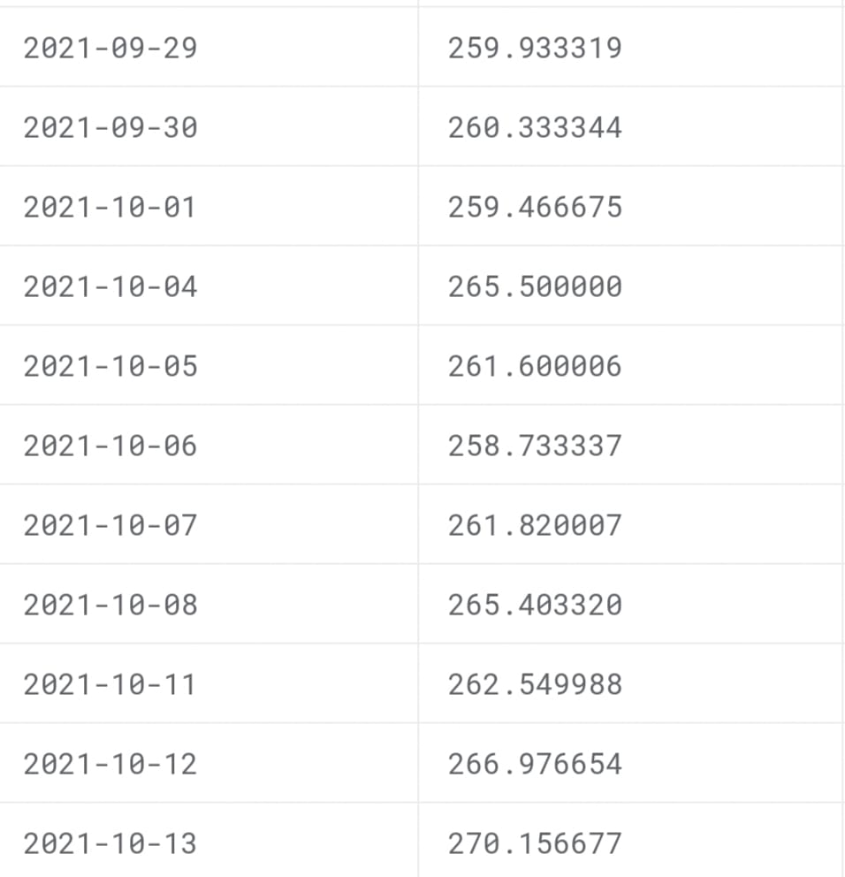
Data set:

Slide 8
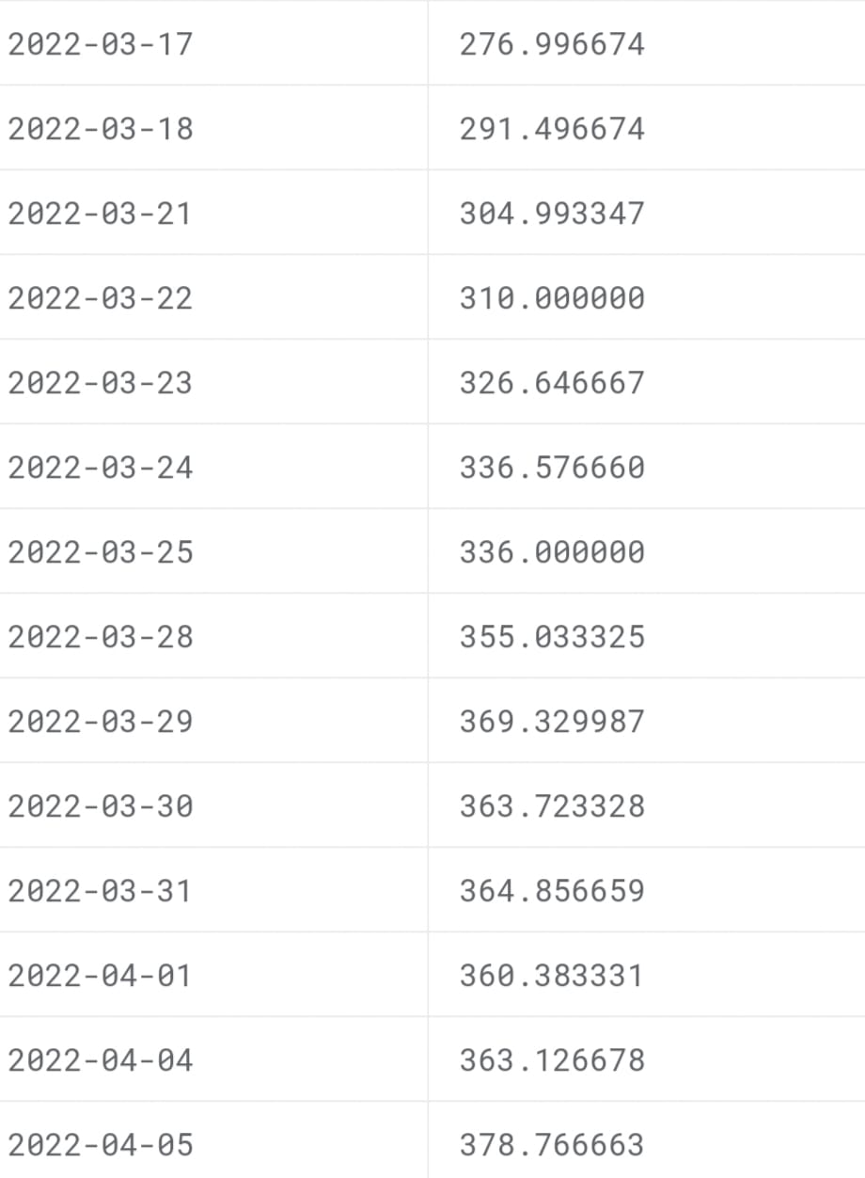

Slide 9
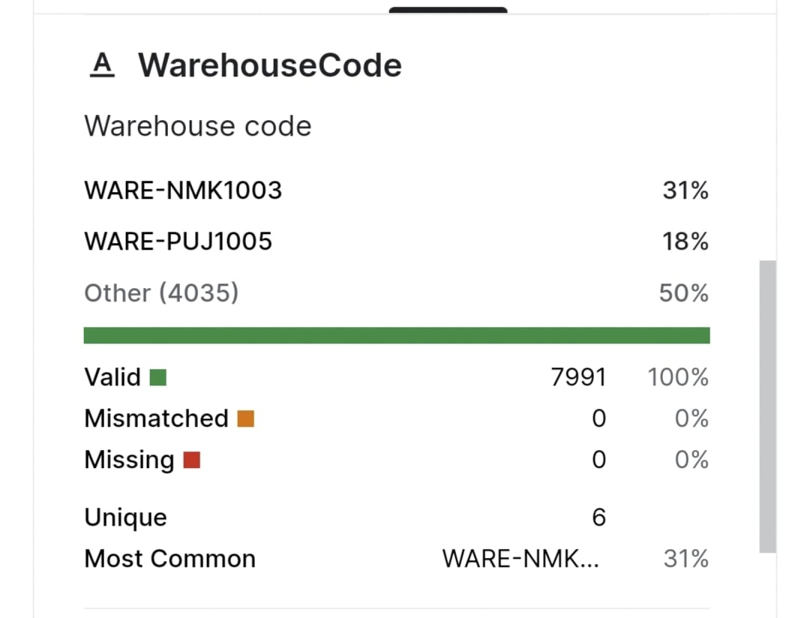

Slide 10
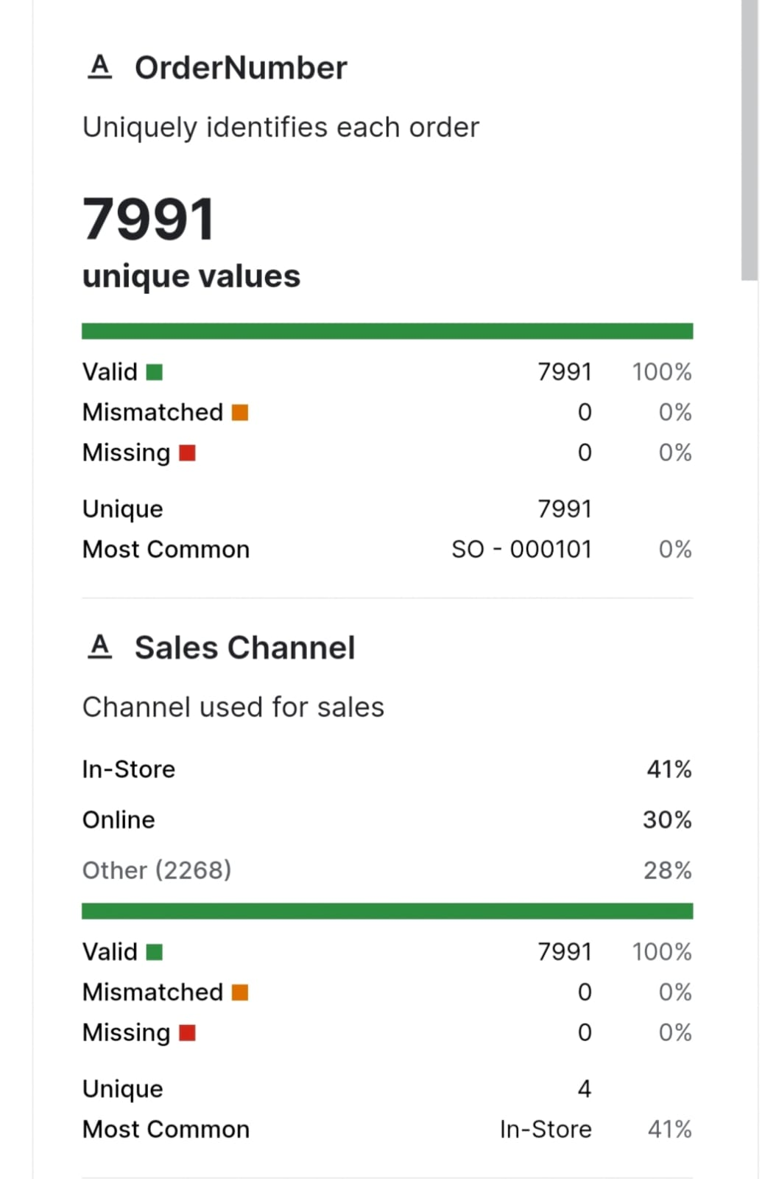

Slide 11
Data processing steps:
Data Cleaning: Removing outliers, correcting inaccuracies, and ensuring data consistency. Handling Missing Values: Imputing missing data using techniques like mean, median, or interpolation. Normalization/Scaling: Scaling features to have consistent ranges for accurate modeling. One-Hot Encoding: Converting categorical variables into numerical form for model compatibility. Feature Selection: Identifying and retaining the most relevant features to reduce model complexity.

Slide 12
FEATURE EXTRACTION TECHNIQUES:
Time-Based Features: Extracting seasonality, trends, and periodic patterns from time-series data.
Lag Features: Creating lag variables to capture historical demand trends.
Statistical Aggregations: Computing statistical measures like mean, median, and standard deviation for different time intervals.
Domain-Specific Features: Incorporating industry-specific attributes relevant to demand prediction.

Slide 13
Model training:
We employed various machine learning models, including Decision Trees, Random Forest, and Gradient Boosting. These models were trained on our preprocessed dataset using historical demand data as input and evaluated for their predictive accuracy. Model hyperparameters were fine-tuned to optimize performance. In the "Product Demand Prediction with Machine Learning" project, we aimed to select the best-performing model for accurate demand forecasting.

Slide 14
Evaluation metrics:
Mean Absolute Error (MAE): Measures the average absolute difference between predicted and actual demand values.
Root Mean Squared Error (RMSE): Quantifies the square root of the average squared differences between predicted and actual demand.
R-squared (R²): Evaluates the proportion of variance in demand explained by the model. Higher R² values indicate better fit.

Slide 15
Conclusion:
Our machine learning models for product demand prediction demonstrated high effectiveness with low error rates, offering valuable real-world applications in optimizing inventory management and enhancing customer satisfaction.

Slide 16
Thank you.

